Slide 1
Disaster Relief Project Detecting Blue Tarps Part 2
NAME Kevin Finity, kf2tg
DATE 2019-11-21
COURSE NAME AND NUMBER SYS 6018

Slide 2
METHODS RESULTS CONCLUSIONS
Software used: R
We tested a series of classification algorithms:
K-Nearest Neighbors (KNN), from the “class” package.
Linear Discriminant Analysis and Quadratic Discriminant Analysis (LDA, QDA), from the “MASS” package.
Logistic Regression (glm).
Random Forest, from the “randomForest” package.
Support Vector Machines (SVM) from the “e1071” package.
We processed the hold out data in “holdout.R”: we used “read.fwf” to load the fixed-width format raw files into a dataframe, then extracted the useful fields and saved them to a CSV.

Slide 3
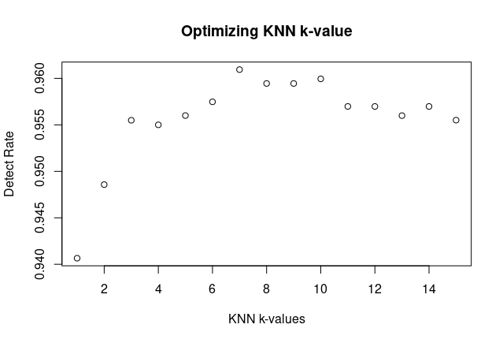
METHODS RESULTS CONCLUSIONS
Pre-processing: the data itself was not altered, but we discarded the categorial “Class” response variable in favor of a binary “Is it a blue tarp” response variable.
Feature engineering: we added two interaction features: “br” or “Blue / Red” and “bg” for “Blue / Green”, to show the relative proportion of blue in each pixel (ie, how blue it is). These features were more helpful with some algorithms than others.
Optimization: several algorithms required parameter optimization:
KNN - We ran 10x cross-validation for each value of k from 1:10, and selected k=7 as having the highest detect rate for the initial data set.

Slide 4
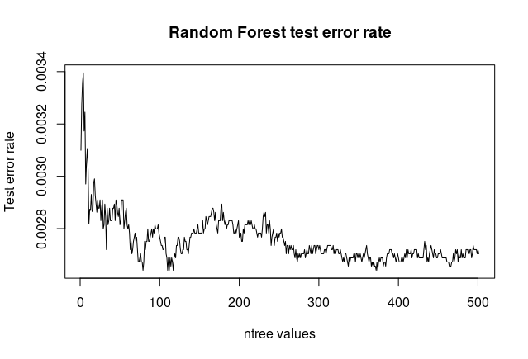
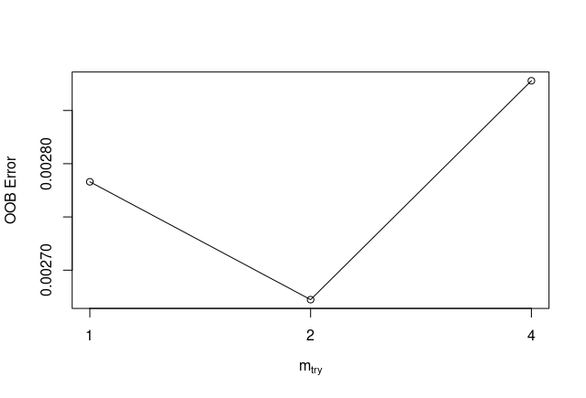
METHODS RESULTS CONCLUSIONS
Random Forest - optimizing "ntree" and "mtry"
note: Since randomForest was much slower to train than the other algorithms, we searched for the optimal parameters using the full initial data set (without cross-validation), then ran 10x CV with the resulting parameters.
ntree: We chose an ntree value of 87, since the test error plot showed a local minimum near that value.
mtry: We chose an mtry value of 2, since that had the lowest out-of-bag error when we ran "tuneRF" on all 5 features.

Slide 5
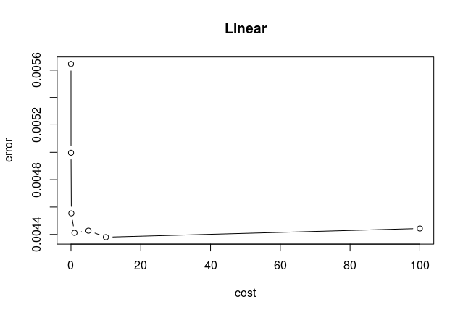
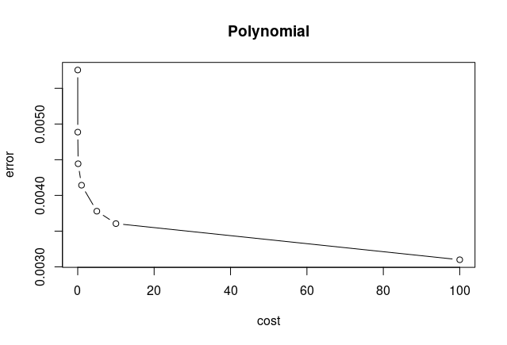
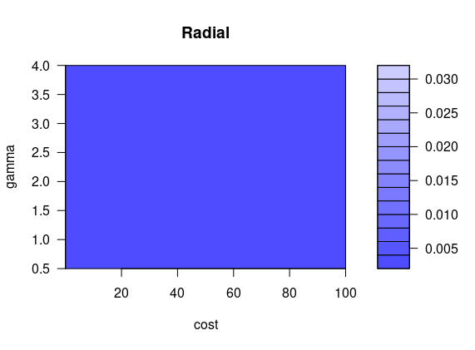
METHODS RESULTS CONCLUSIONS
SVM - optimizing kernel selection and parameters
For each kernel (linear, polynomial, radial), we tuned the "cost" (and "gamma" for radial) parameters using 10x cross-validation using the "tune" function.
We selected the kernel and parameters with the lowest CV error rate: radial kernel, cost=10, gamma=4. CV error: 0.00262

Slide 6
METHODS RESULTS CONCLUSIONS
Performance Metrics, 10x Cross-Validation:
Method: | Detect Rate: | False Alarm Rate
KNN (K = 7 ) (3 features) | 0.977 | 0.00153
LDA | 0.841 | 0.000816
QDA | 0.970 | 0.00268
Logistic Regression | 0.904 | 0.00162
Random Forest (3 feat.) | 0.950 | 0.00134
SVM (radial) | 0.978 | 0.000898
Random Forest parameters: ntree=87, mtry=2 SVM parameters: cost=10, gamma=4
Notes:
Fill in the detection and false alarm rates you get for each method.
Fill in the value you used for K in KNN, your parameters for random forest, and the kernel you used for SVM.
For a 5% bonus, add another column and include AUC (area under the curve) values for each method.
‹#›

Slide 7
METHODS RESULTS CONCLUSIONS
Performance Metrics, Hold-Out Data:
Method: | Detect Rate: | False Alarm Rate
KNN (K = 7 ) (3 features) | 0.830 | 0.00651
LDA | 0.983 | 0.0172
QDA | 0.992 | 0.0338
Logistic Regression | 0.990 | 0.0246
Random Forest (3 feat.) | 0.790 | 0.00528
SVM (linear) | 0.990 | 0.0325
Random Forest parameters: ntree=87, mtry=2 SVM parameters: cost=1
Notes:
Fill in the detection and false alarm rates you get for each method.
Fill in the value you used for K in KNN, your parameters for random forest, and the kernel you used for SVM.
For an additional 5% bonus, add another column and include AUC (area under the curve) values for each method
For an additional 5% bonus, add another slide with ROC curves for all methods.
‹#›

Slide 8
METHODS RESULTS CONCLUSIONS
Conclusions:
The high flexibility algorithms (KNN, Random Forests, SVM) were easily overtrained on the initial data, with poor holdout results.
We originally selected a radial kernel for SVM based on its low error rate, but it performed so poorly on the holdout data (detect rate 0.25) that we switched to a simpler linear kernel, with much better results.
We suspect that random forests might have performed better if the parameters were selected using cross-validation, but it seemed computationally prohibitive for this application.
In retrospect, the reduced test performance when adding the 2 interaction features could have been a sign of overtraining.
Notes:
State some conclusions here. One of your conclusions must be your determination of which algorithm works best in the Hold-Out data. You must have at least 6 conclusions.
‹#›

Slide 9
METHODS RESULTS CONCLUSIONS
Conclusions:
The overfitted algorithms also had the lowest false alarm rates on the hold out data, suggesting a detection-false-alarm tradeoff.
We recommend QDA - it had the best detection rate on the hold out data, and also performed reasonably well on the initial data set. It also trains relatively fast.
However, we would nominate Linear Regression as the runner-up. Its detection rate was lower than QDA (and the same as linear SVM), but it had a relatively low false alarm score for its detection rate. Depending on the application, this could be desirable.
Notes:
State some conclusions here. One of your conclusions must be your determination of which algorithm works best in the Hold-Out data. You must have at least 6 conclusions.
‹#›

Slide 10
METHODS RESULTS CONCLUSIONS
Conclusions:
QDA confusion matrix:
Reference
Prediction Blue Tarp Not Blue Tarp
Blue Tarp 14363 67164
Not Blue Tarp 117 1922533
Logistic Regression confusion matrix:
Reference
Prediction Blue Tarp Not Blue Tarp
Blue Tarp 14338 49031
Not Blue Tarp 142 1940666
Notes:
State some conclusions here. One of your conclusions must be your determination of which algorithm works best in the Hold-Out data. You must have at least 6 conclusions.
‹#›

